Slide 1
ECE3 PROJECT TIPS
DON’T PRINT OUT TRACK!

Slide 2
DOCUMENT YOUR DEVELOPMENT TESTS!
DON’T DO THIS!
”It must be noted that the above data is only a sampling of the most “mile stone” data points where I got it to handle a significant part of the track like the offset, at least two dozen more tests were done that yielded fruitless results that I did not feel were important enough to record.“
(Quoted from student Final Report)

Slide 3

DELAYS ARE DEATH!
SERIAL.PRINTS ARE NEAR-DEATH!
“The big issue with my code, discovered late on Race Day, was that I had serial prints, which slowed down the execution dramatically.
REMOVE SERIAL PRINTS WHEN TESTING YOUR CAR!”
(Quoted from student Final Report)

Slide 4
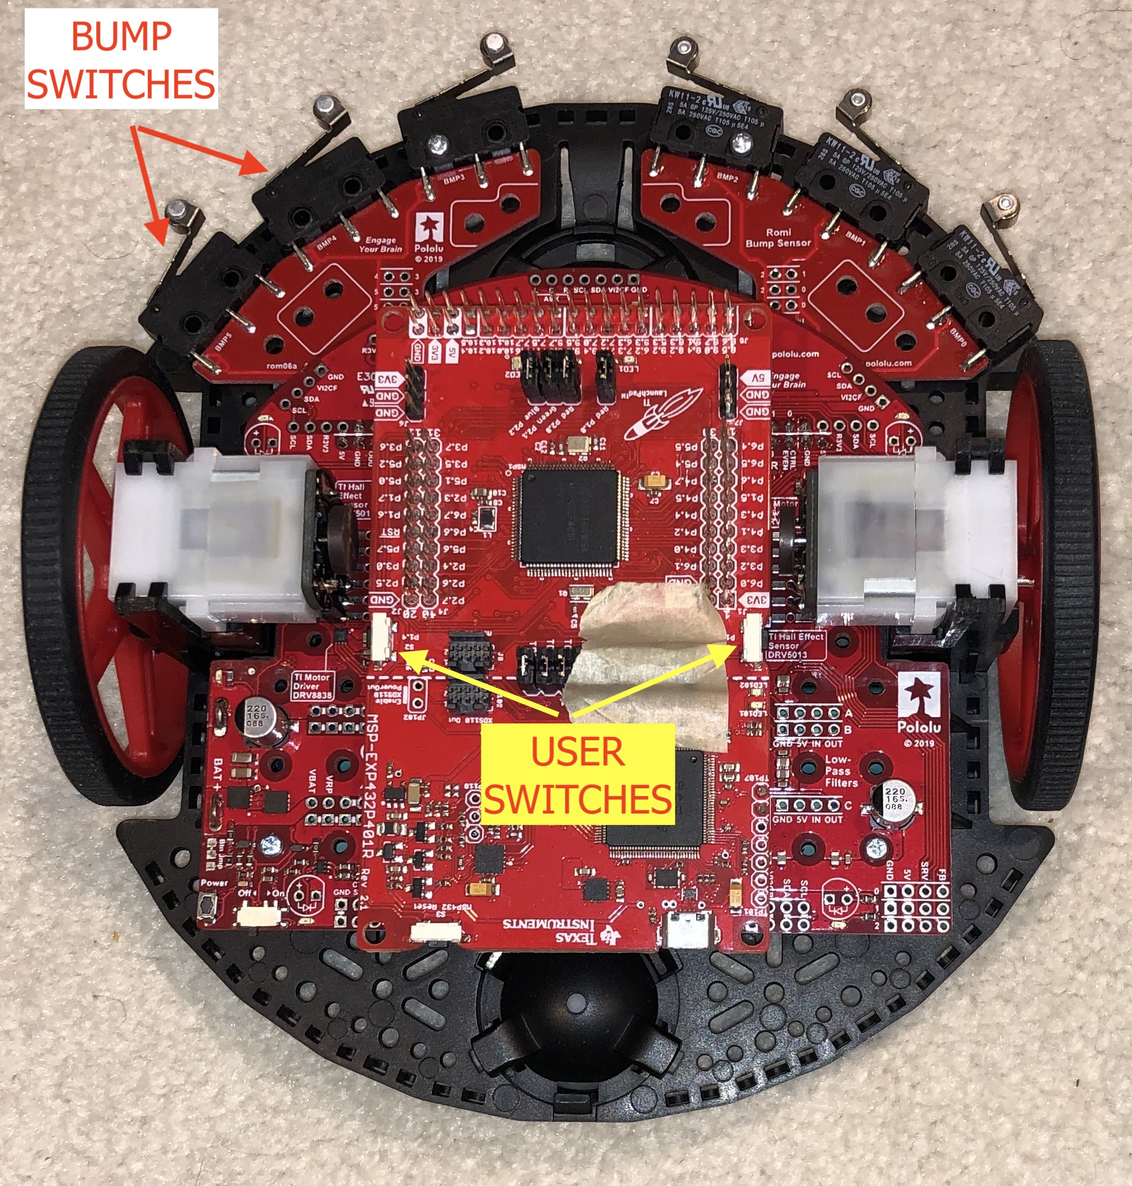
USE BUMP AND USER SWITCHES
You can control your program:
Base Speed
PID gains
Etc.
Pin Chart has pin #s for bump switches.
User switch pin #s:
Sw# Pin#
S1 73
S2 74

Slide 5
DO A SELF-CALIBRATION AT THE START OF EACH RUN
Set the car on all white near the start.
Take a series of readings. These replace your subtraction values in the fusion algorithm.
Set the car in the starting position and let it go.

Slide 6
VISIBLE LIGHT DOESN’T COUNT
BUT SUNLIGHT CONTAINS IR
“… the IR reading for white paper would go from around 550 under daylight to around 750 under artificial lights at night.“
“I made the mistake of trying to record the sensor data in a room filled with natural light, which ended up giving me abnormal values. “
(Quoted from student Final Reports)

Slide 7
WHERE TO START WITH K_{P}?
Pick a base PWM (speed). 60-90 (255 is max) is a good starting point.
Choose K_{P} so that a change from zero error to max error causes a change in the base PWM that is ~50% of the base PWM.

Slide 8
HARD SURFACE, BUT NO TABLETOPS!
EXCEPT FOR STATIC TESTS.
“The night before race day my car had fallen off my bed and the motor and wheel had come off the right side,…”
(Quoted from student Final Report)

Slide 9
STRAIGHT TRACK FIRST
TO BE SURE THE CAR IS STABLE.
Start the car from one of the start positions
Wheels should not touch the narrowing lines.

Slide 10
DEBUG TIPS
Use LEDs to signal something of importance in the code.
Always have fresh batteries on hand.
Check the signs of K_{P} and K_{D},
Isolate K_{P} from K_{D}
Set K_{D} to zero.
Place car offset from, but parallel to, the track.
Watch the first turn.
Set K_{P} to zero.
Place the car offset from, but angled toward, the path.
Watch the first turn.
Detect when car has left the path.
Develop path recovery algorithm.

Slide 11
DON’T USE DOUBLE!
This is real-time, embedded system programming that you are doing.
Limited resources in embedded computing.
Float is fine.

Slide 12
EXTRA CREDIT
Less than 15 seconds round trip.
TAs or mentors will keep time.
You must have camera looking at car on Race Day.

Slide 13
finis

